Slide 1
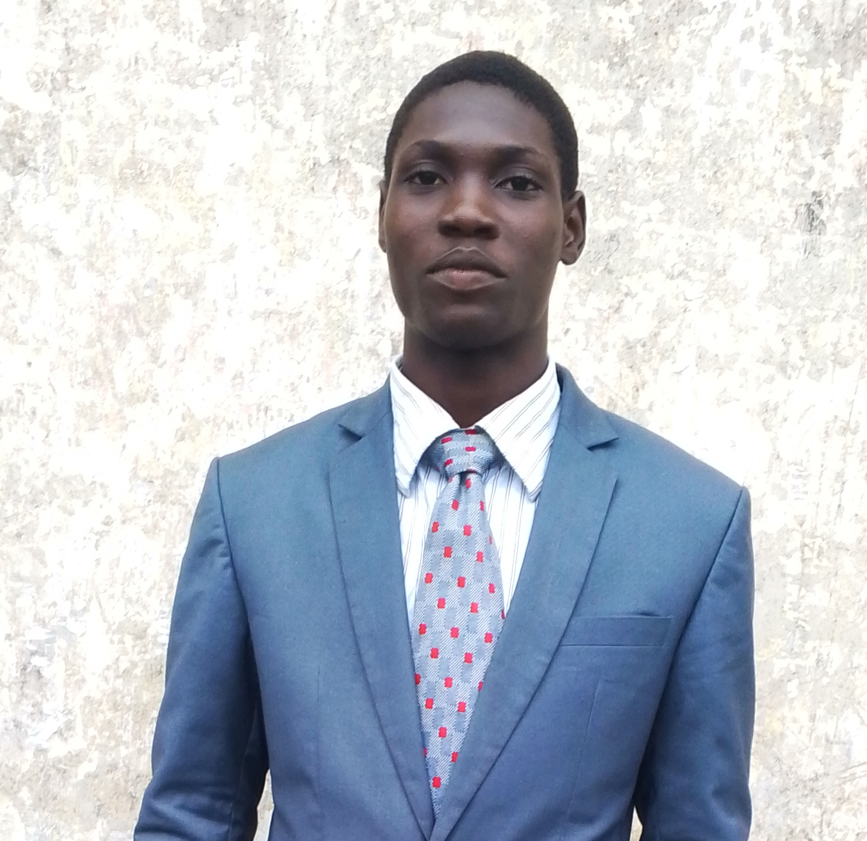
PHISHING AWARENESS TRAINING
PREPARED BY
TORITSEJUWE PLEASANT

Slide 2
INTRODUCTION
WHAT IS PHISHING?
Phishing is a cyberattack where attackers trick people into revealing sensitive information such as:
Password
Bank details
ATM PINs
OTP codes
Attackers usually use:
Fake emails
Fake websites
SMS messages
Social engineering

Slide 3
TYPES OF PHISHING
COMMON TYPES OF PHISHING
Email Phishing
Fake emails pretending to be from trusted companies
2. Smishing
Phishing through SMS messages
3. Vishing
Phishing through phone calls
4. Fake Website
Cloned websites used to steal login information

Slide 4
SIGNS OF PHISHING EMAILS
HOW TO RECOGNIZE PHISHING EMAILS
Urgent messages
Poor grammar
Suspicious sender address
Unknown attachments
Fake links
Requests for passwords or OTP
Example
Fake:
Plain text
support@paypa1.com
Real:
Plain text
support@paypal.com

Slide 5
FAKE WEBSITES
HOW TO IDENTIFY FAKE WEBSITES
Wrong spelling in URLs
No HTTPS security
Poor website design
Pop-up requests for passwords
Strange payment requests
Example
Real:
Plain text
https://facebook.com
Fake:
Plain text
https://faceb00k-login.com

Slide 6
SOCIAL ENGINEERING
WHAT IS SOCIAL ENGINEERING?
Social engineering means manipulating people psychologically.
Attackers use:
Fear
Urgency
Fake rewards
Trust
Example
“Your bank account will be blocked today”

Slide 7
BEST PRACTICES
HOW TO STAY SAFE
Never c lick suspicious links
Verify email senders
Use strong passwords
Enable Two-Factor Authentication
Keep software updated
Avoid public Wi-Fi for banking

Slide 8
REAL-LIFE EXAMPLE
EXAMPLE SCENARIO
A victim receives:
“Your WhatsApp account will expire today”
The victim clicks the links and enters login details on a fake website.
The attacker steals the account.

Slide 9
Quiz
Quiz Time
Question 1
Which is a sign of phishing?
A. HTTPS security B. Urgent warning messages C. Official domain D. Verified account
Answer:
B
Question 2
What should you do before clicking a link?
Answer:
Verify the URL first

Slide 10
CONCLUSION
CONCLUSION
Phishing attacks are common but preventable.
Always:
Think before clicking
Verify websites
Protect personal information
Stay cybersecurity aware

